Slide 1

Bellabeat - Smart Device Usage Analysis
Google Data Analytics Capstone Project
Prepared by : Chandru m
Tools Used – Excel, SQL(big Query)

Slide 2
Executive summary
Key findings :
the analysis found that users recorded an average of 6,547 steps per day, which is below the commonly used 10,000-step benchmark.
around 43% of recorded days had fewer than 5,000 steps, showing an opportunity to encourage users to move more.
activity levels changed throughout the day, with higher step counts around noon and 7 PM.
tuesday had the highest share of low-activity records, while Wednesday had the lowest.
Key recommendation : Bellabeat could encourage users to stay active through personalized reminders, daily step goals, and activity suggestions at suitable times.

Slide 3
Data overview
About the data :
This analysis uses Fitbit smart-device data to understand users' daily activity patterns and identify opportunities for Bellabeat to improve its wellness experience.
Dataset details :
35 users included in the daily activity dataset.
457 records covering March 12 to April 12, 2016.
Data includes daily steps, distance, calories burned, and activity levels.
Excel and SQL were used to explore and analyze the data.
Objective : To understand users' activity habits and suggest ways Bellabeat could encourage a more active lifestyle

Slide 4
Daily Activity Levels
43.1% of recorded days had lower than 5k steps, while only 27.8% reached 10k steps or more.
Bellabeat could encourage users to increase their daily steps through achievable goals and regular reminders.
Average Steps by Hour of the Day
Activity peaked around noon and 7 PM, while the lowest activity was recorded during the early morning hours.
Bellabeat could test sending movement reminders during less active periods to encourage users to move more.

Slide 5
Daily Average Steps Over Time
Average daily steps fluctuated throughout the month, with several rises and drops.
Activity was generally higher in early April than during some days in March, although there were a few sharp dips.
Low-Activity Records by Weekday
Tuesday had the highest share of low-activity records at 52.1%, followed by Sunday at 50%.
Wednesday had the lowest share at 31.3%, showing that low activity varied across the week.

Slide 6
Recommendations
1. Set achievable daily goals
Encourage users to gradually increase their daily steps through realistic, personalized targets.
2. Send timely reminders
Test movement reminders during less active periods to encourage users to take short walks.
3. Personalize the experience
Use activity patterns to suggest goals and reminders that suit different user habits.
4. Encourage consistency
Introduce weekly progress updates to help users track their activity and stay motivated.

Slide 7
Conclusion and Limitations
Conclusion
The analysis shows that daily activity varies across users, weekdays, and hours. Bellabeat could use these insights to test personalized goals and reminders that encourage users to move more.
Limitations
The analysis covers only 35 users over one month.
The data is from 2016 and may not reflect current user habits.
The findings show activity patterns but do not explain why users behave this way.
The results may not represent all Bellabeat customers.

Slide 8
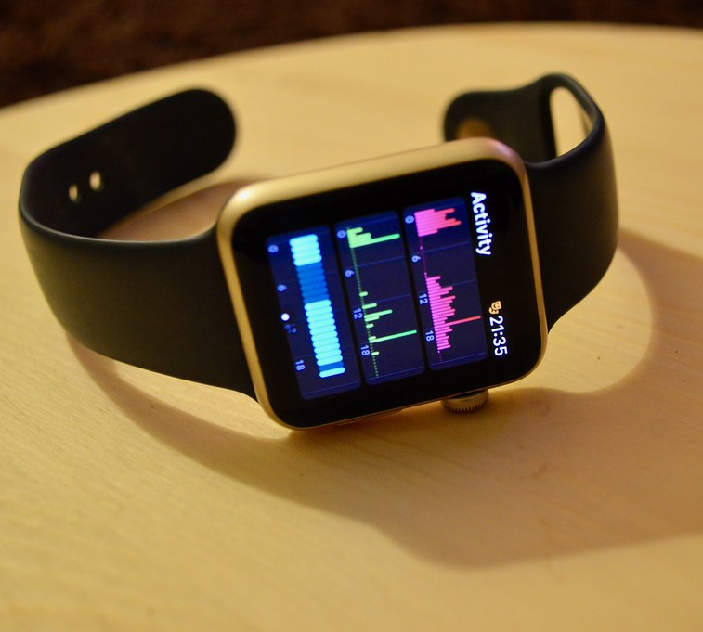
Thank you :)
This Photo by Unknown Author is licensed under CC BY

